Slide 1


Slide 2
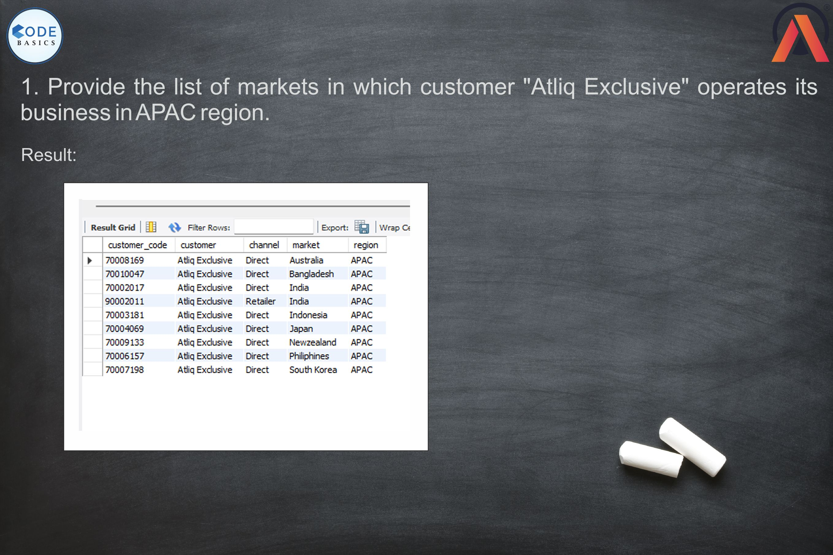

Slide 3
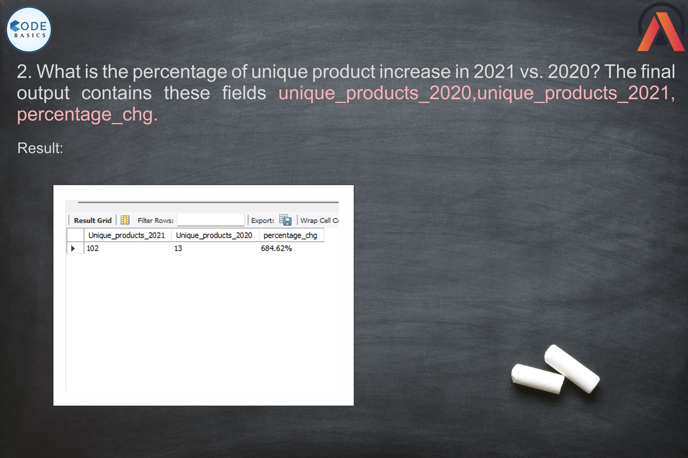

Slide 4

Notes:
Unique products in 2020 =13, in 2021=102 chg% is 684.62%
difference is 89
245-13=232
232+102=334

Slide 5
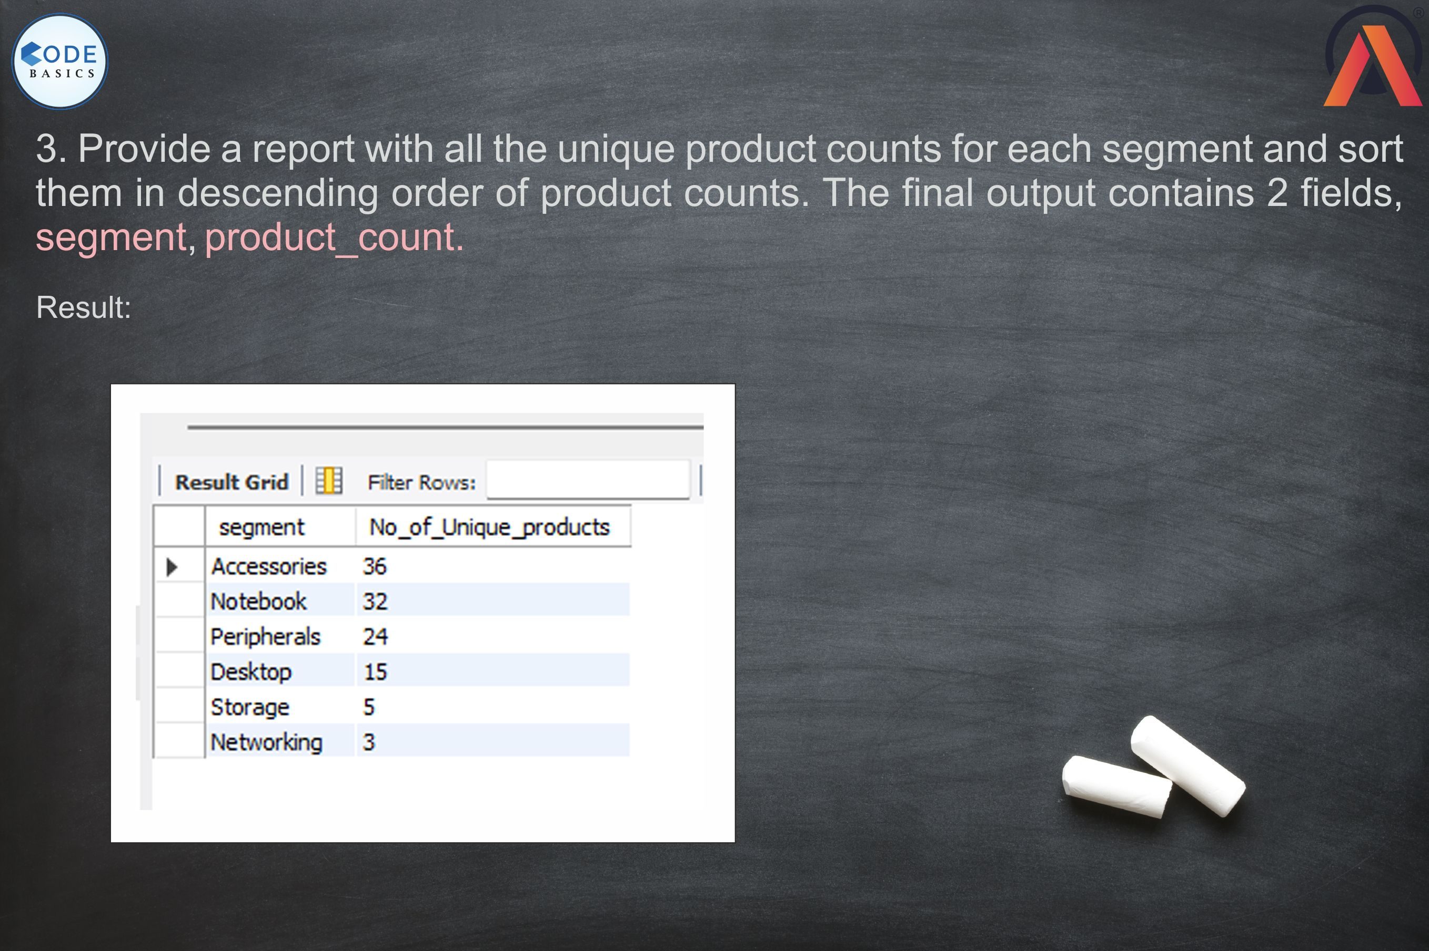


Slide 6


Slide 7
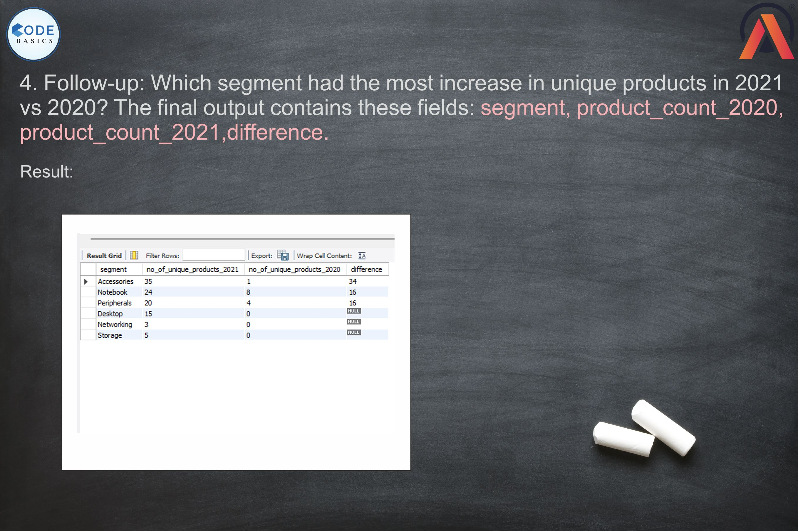


Slide 8



Slide 9
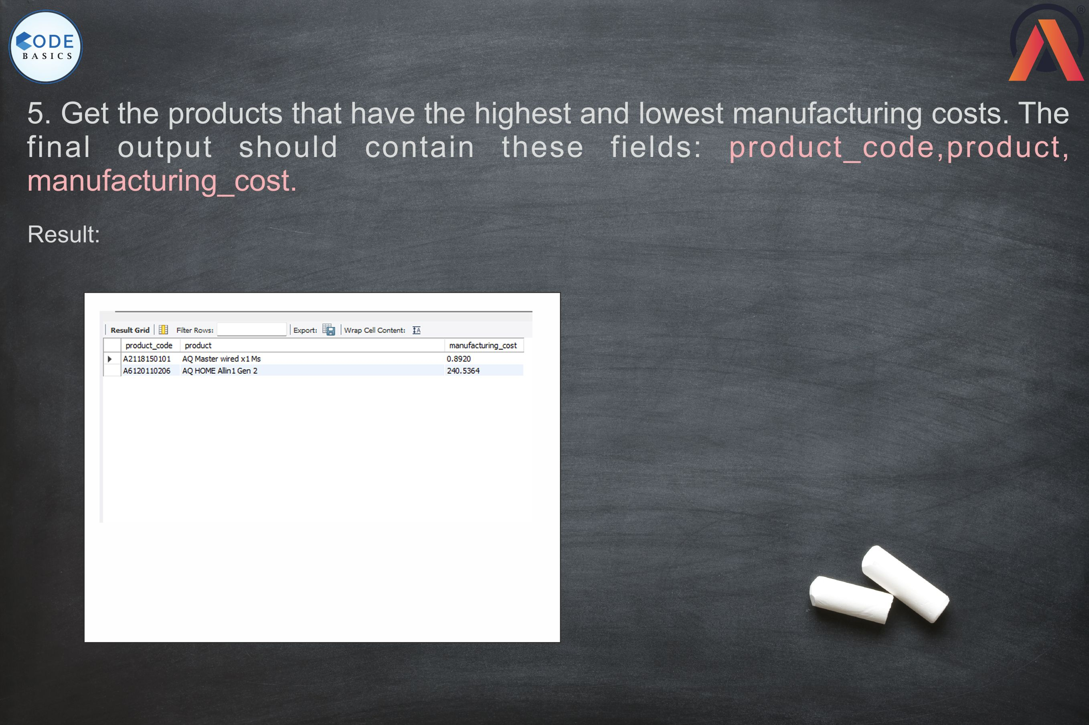

Slide 10
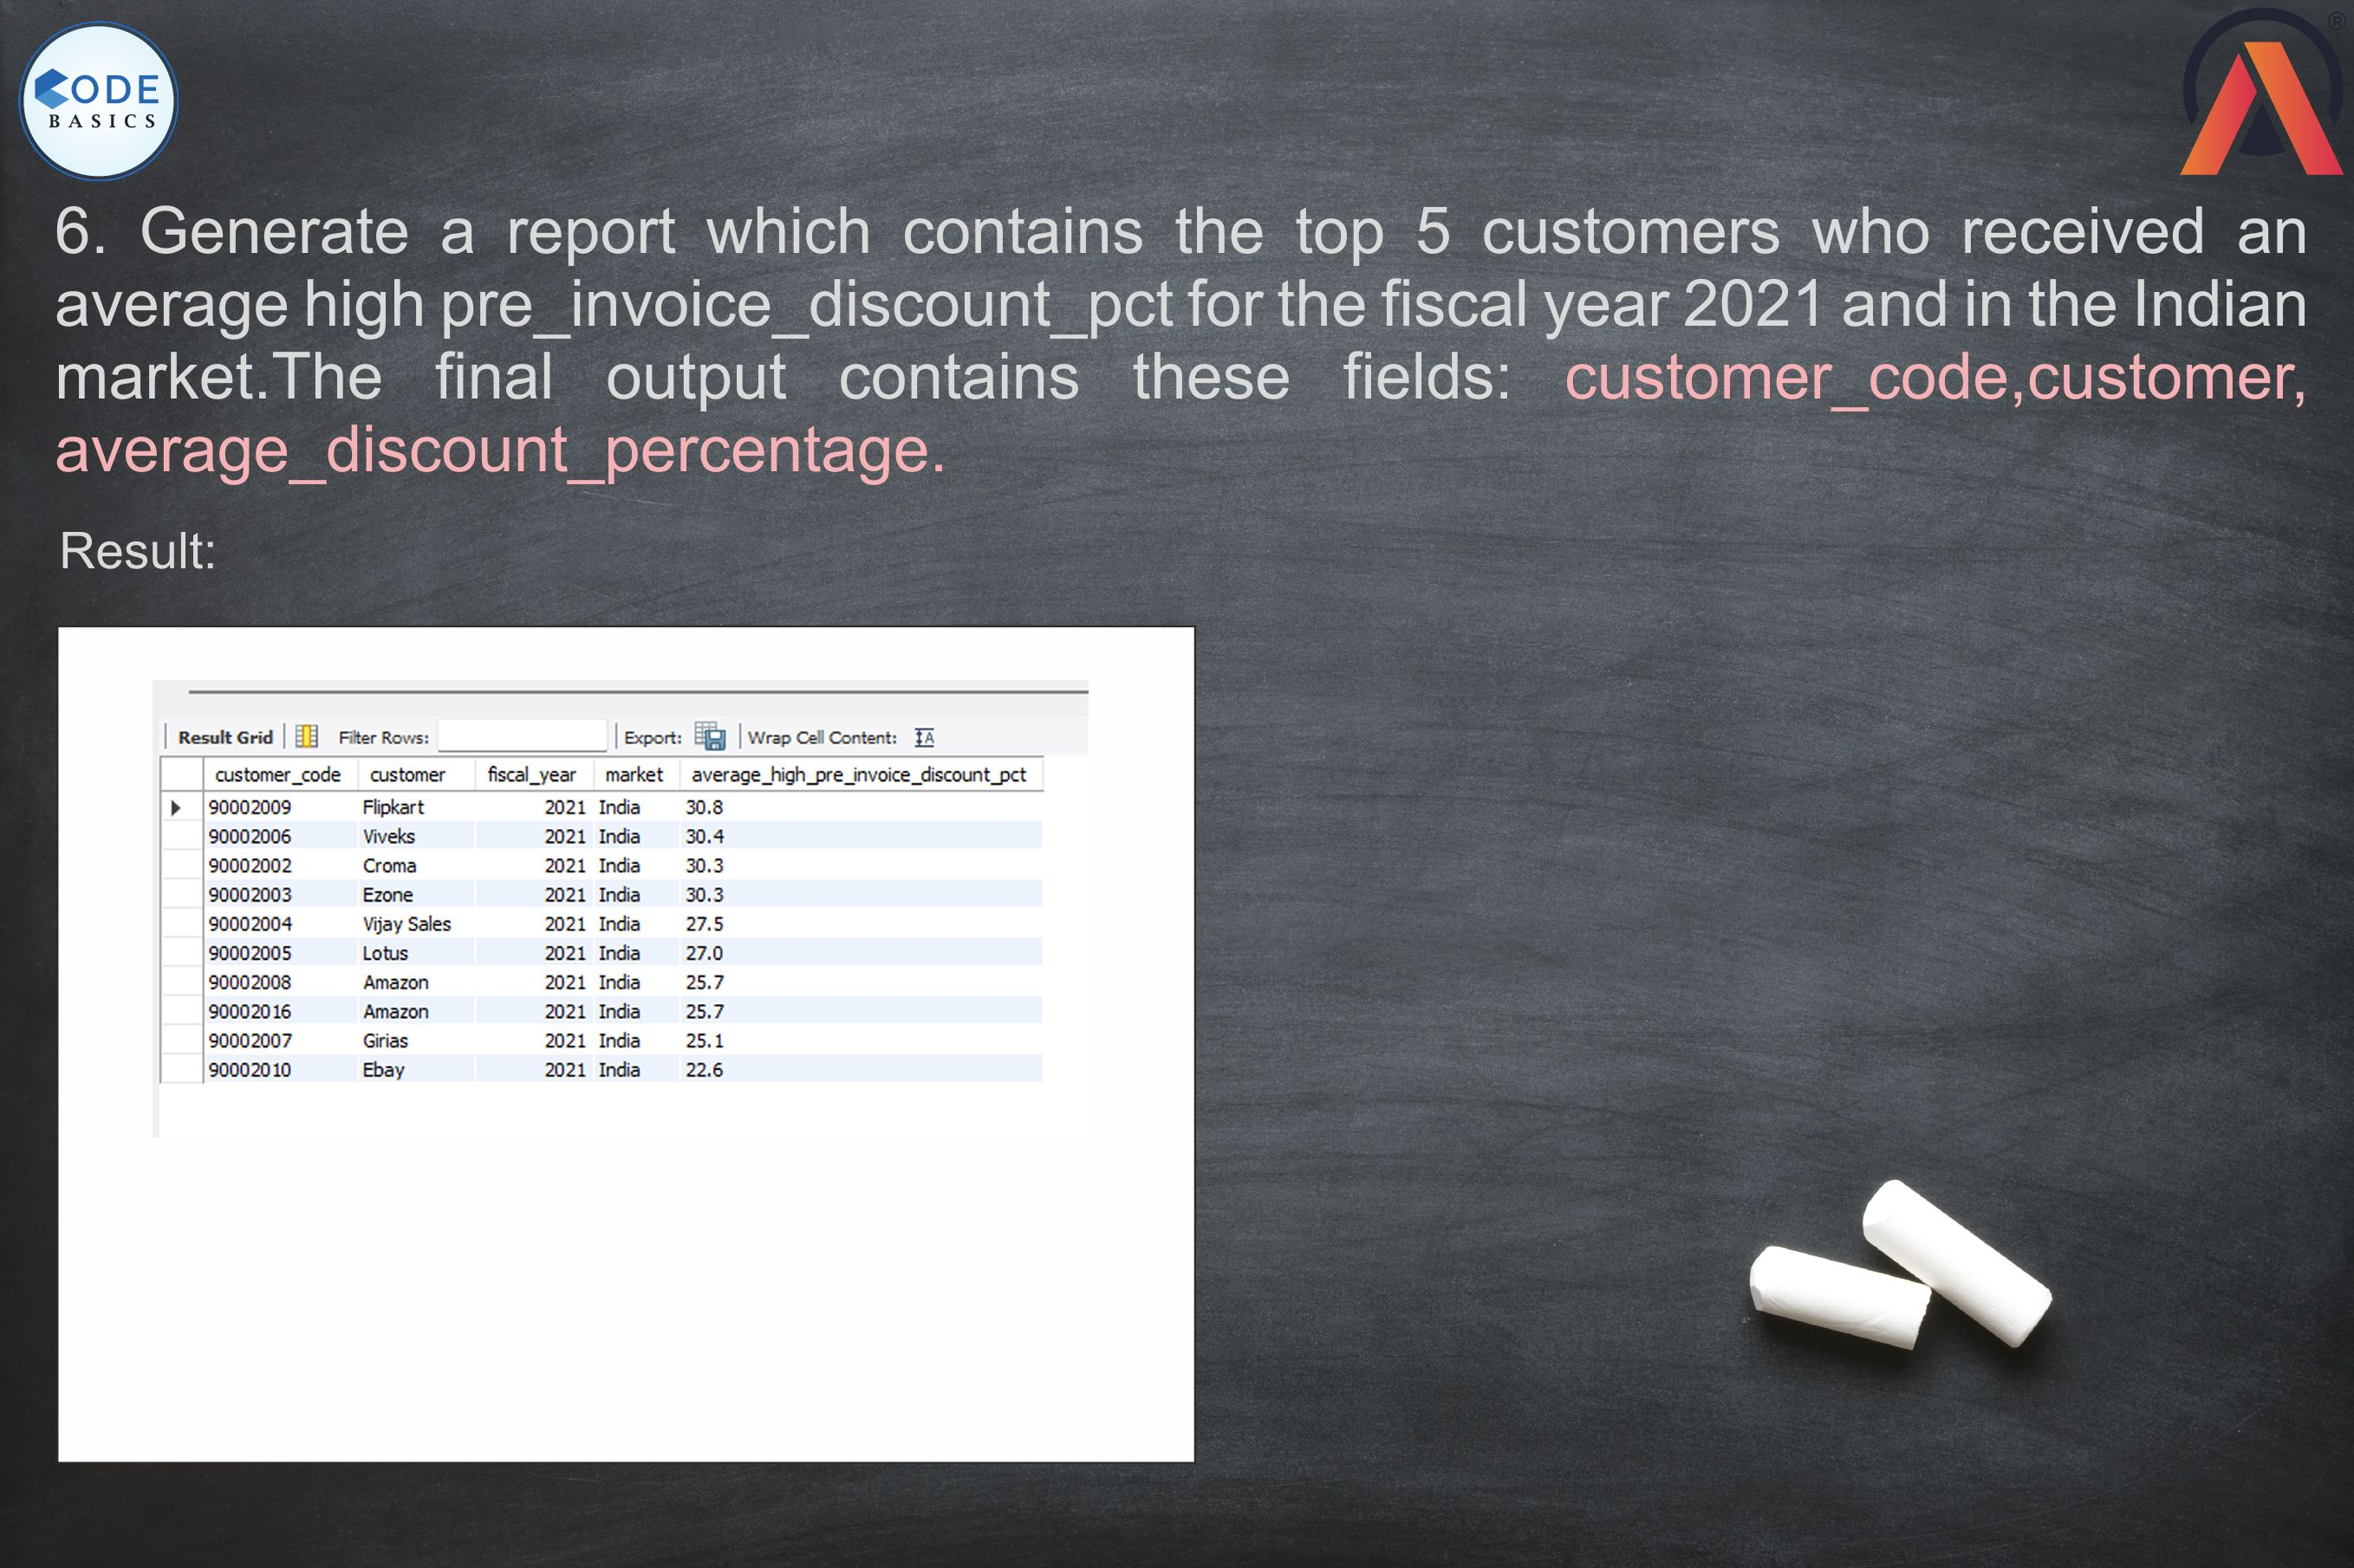

Slide 11


Slide 12


Slide 13
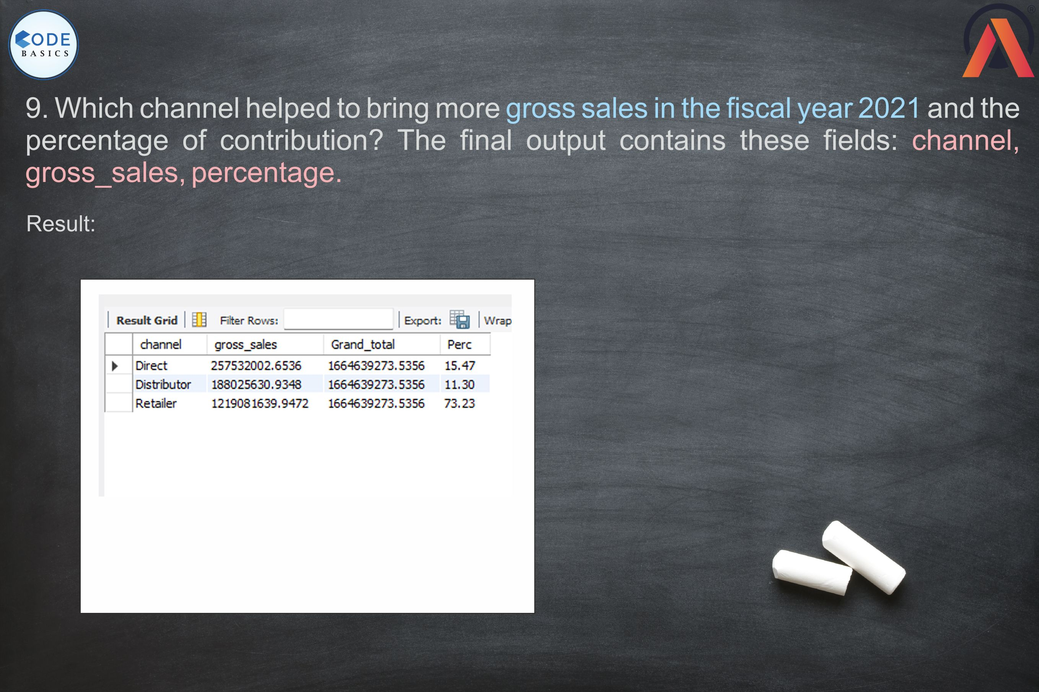

Slide 14

Submitted by M. Vamsi Kumar

